Slide 1
Chapter 5 Fundamentals of TCP/IP Configuration
ES327 – Computer Networks & Data Communication
Dr. Omayma Younis

Slide 2
Learning Objectives
Understand the different numbering systems (binary, decimal and hexadecimal), and convert between them.
Differentiate between the classful IP ranges and their corresponding subnet masks.
Learn how and why private IP addresses are used.
Identify the structure of IP addresses (IPv4 & IPv6).
Understand the main TCP/IP utilities, used for managing and troubleshooting the network.

Slide 3
Review of Numbering Systems
Before we start this chapter, you should have a good understanding of the different numbering system (e.g. binary, decimal, hexadecimal).
A computer understands only two values, 1 (one) and 0 (zero).
If you are familiar with binary, decimal, and hexadecimal numbering, you can skip this part.
Let’s see … Test yourself ...

Slide 4
DEC | HEX | BIN
0 | 0 | 0000
1 | 1 | 0001
2 | 2 | 0010
3 | 3 | 0011
4 | 4 | 0100
5 | 5 | 0101
6 | 6 | 0110
7 | 7 | 0111
8 | 8 | 1000
9 | 9 | 1001
10 | A | 1010
11 | B | 1011
12 | C | 1100
13 | D | 1101
14 | E | 1110
15 | F | 1111
Review of Numbering Systems
The Binary digits are only 0 and 1.
The Decimal digits ranges from 0 to 15.
The hexadecimal digits ranges from 0 through 9, and the letters A through F.

Slide 5
Review of Numbering Systems
The number system recognized by computers is known as the binary system and is based on powers of 2.
Binary values are read from right-to-left, instead of left-to-right.
The following figure represents the first eight binary values.
2⁷
2⁶
2⁵
2⁴
2³
2²
2¹
2⁰
128
64
32
16
8
4
2
1

Slide 6
Review of Numbering Systems
Converting from Binary-to-Decimal:
= (41)₁₀
32
16
8
4
2
1
1
0
1
0
0
1
= (76)₁₀
64
32
16
8
4
2
1
1
0
0
1
1
0
0
128
64
32
16
8
4
2
1
= (255)₁₀
1
1
1
1
1
1
1
1

Slide 7
Review of Numbering Systems
Converting from Decimal-to-Binary:
(67)₁₀ =
64
32
16
8
4
2
1
1
0
0
0
0
1
1
(30)₁₀ =
16
8
4
2
1
1
1
1
1
0
(192)₁₀ =
128
64
32
16
8
4
2
1
1
1
0
0
0
0
0
0

Slide 8
Review of Numbering Systems
Converting from Binary-to-Hexadecimal:
= (29)₁₆
8
4
2
1
8
4
2
1
1
0
1
0
0
1
= (4C)₁₆
8
4
2
1
8
4
2
1
1
0
0
1
1
0
0
8
4
2
1
8
4
2
1
= (FF)₁₆
1
1
1
1
1
1
1
1

Slide 9
Review of Numbering Systems
Converting from Hexadecimal-to-Binary:
(A2)₁₆ =
8
4
2
1
8
4
2
1
1
0
1
0
0
0
1
0
(B)₁₆ =
8
4
2
1
1
0
1
1
(6CD)₁₆ =
8
4
2
1
8
4
2
1
8
4
2
1
0
1
1
0
1
1
0
0
1
1
0
1

Slide 10
Review of Numbering Systems
Converting from Decimal-to-Hexadecimal:
Two steps to do:
First, convert from Decimal to Binary.
Then, convert from Binary to Hexadecimal.
(45)₁₀
(101101)₂
(2D)₁₆

Slide 11
Review of Numbering Systems
Converting from Hexadecimal-to-Decimal:
Two steps to do:
First, convert from Hexadecimal to Binary.
Then, convert from Binary to Decimal.
(45)₁₆
(0100 0101)₂
(69)₁₀

Slide 12
Review of Numbering Systems
Perform the numbering conversions to complete the following table:
Binary Number | Decimal Number | Hexadecimal Number
10101
11001110
 | 45
 | 76
 |  | 76
 |  | 123
 |  | A1

Slide 13
Review of Numbering Systems
Perform the numbering conversions to complete the following table:
Binary Number | Decimal Number | Hexadecimal Number
10101 | 21 | 15
11001110 | 206 | CE
101101 | 45 | 2D
1001100 | 76 | 4C
1110110 | 118 | 76
100100011 | 291 | 123
10100001 | 161 | A1

Slide 14
TCP/IP Configuration Fundamentals
Now, this section will introduce you to the configuration fundamentals of TCP/IP.
When you configure TCP/IP, you are required to know the settings for the IP address, subnet mask, and default gateway.
IP address
Subnet mask
Default gateway

Slide 15
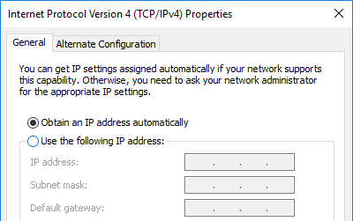
IP Address
The following two ways exist to configure systems to use IP addresses:
Automatic (Dynamic) addressing: IP address is obtained automatically via Dynamic Host Configuration Protocol (DHCP).
Static addressing: the network administrator enters IP address manually.

Slide 16
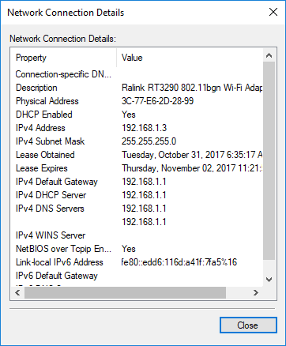
IP Address
The following two ways exist to configure systems to use IP addresses:
Automatic (Dynamic) addressing: IP address is obtained automatically via Dynamic Host Configuration Protocol (DHCP).
Static addressing: the network administrator enters IP address manually.

Slide 17
IP Address
Using either way, each device in a TCP/IP network must be configured with an IP address and a subnet mask.
The IPv4 address is expressed in a four-part dotted decimal format, such as:
192.168.1.3
Each decimal value is made up of 8 bits (1s and 0s), and there are four decimal values, so 8 bits times 4 equals the 32-bit address.
Since each of the decimal values is made up of 8 bits (for example, the 192), we refer to each of the decimal values as an octet (i.e. byte). There are four octets in an IP address.

Slide 18
Subnet Mask
It is very important to understand that the four octets in an IP address are divided into two parts:
Network ID
Host ID
The subnet mask determines the number of bits that make up the Network ID and the number of bits that make up the Host ID. Let’s see how this works.

Slide 19
Subnet Mask
The subnet mask breaks the IP address into: a Network ID part and a Host ID. It looks like the following example:
255.255.255.0
If there is a (255) in an octet of the subnet mask, then the corresponding octet in the IP address is part of the Network ID.
For example, if the IP address is (192.168.1.10) and the subnet mask is (255.255.255.0), the first three octets (192.168.1) would make up the Network ID and the last octet (10) would be the Host ID.
Another example, a subnet mask of (255.0.0.0), means that the first octet of the IP address is used as the Network ID portion, while the last three octets are the Host ID portion of the IP address.

Slide 20
Subnet Mask
Q: Why do we need a subnet mask that breaks the IP address into a Network ID part and a Host ID?
A: It indicates whether systems exist on the same network or not, by comparing the network IDs.
For example, when a system such as (192.168.1.15), with a subnet mask of (255.255.255.0), sends data to (192.168.45.10); this means that the two systems are on two different networks. Therefore, the data will need to be passed to the router, so that the router can send the data to the other network.
But, when a system such as (128.70.40.5) with a subnet mask of (255.255.0.0), sends a piece of data to (128.70.32.6); this means that the two systems exist on the same network. Therefore, the data is sent without the use of a router.

Slide 21
Default Gateway
Talking about devices residing at different networks, introduces the purpose of the “default gateway”. A default gateway is often referred to simply as “gateway”.
When your system wants to send data to another system on the network, it looks at its own network ID and compares that to the destination system’s IP address.
If both systems have the same network ID, the data is sent directly from your system to the destination system. But, if the two systems are on different networks, your system must pass the data to the router so that the router can send the data to the destination system’s router.
Q: How does your system know who the router is?
A: The default gateway is the IP address of the router that can send data from your network to another network.

Slide 22
More about IP addressing
There are five classes of IP addresses (classes A through E).
The Internet community defined these classes to accommodate networks of various sizes.
The most common classes in use are: Class A, Class B, Class C, defined as follows:
Class | First IP Octet | Default Subnet Mask | Max. no. of hosts per network
Class A | 1.x.x.x to 126.x.x.x | 255.0.0.0 | 2²⁴ -2 = 16,777,214
Class B | 128.x.x.x to 191.x.x.x | 255.255.0.0 | 2¹⁶ -2 = 65,534
Class C | 192.x.x.x to 223.x.x.x | 255.255.255.0 | 2⁸ -2 = 254
Class D | 224.x.x.x to 239.x.x.x | Used for special types of applications (multicasting)
Class E | 240.x.x.x to 247.x.x.x | Used for research purposes only

Slide 23
Reserved IP Addresses
Internal Loopback Address
You are not allowed to have a host assigned an IP address that has a value of 127 in the first octet. This is because this IP address of 127 has been reserved for the loopback address.
The loopback address is used to refer to the local system, also known as the localhost. If you want to verify that the TCP/IP software has initialized on the local system, you may ping the loopback address, which is typically referred to as 127.0.0.1.
It allows the host to send a test packet to itself without generating network traffic.

Slide 24
Reserved IP Addresses
Broadcast Address
A broadcast address is a reserved IP address whose Host ID is (255).
The broadcast address is used by applications and hosts to send a message to all hosts on a network.
For example the IP address 172.16.255.255 (Class B), specifies all the hosts on a network whose ID is (172.16). Thereby, any message sent to this IP address is broadcasted to all the hosts on the network

Slide 25
IPv6: The new generation of IP addresses
Our entire discussion so far about TCP/IP is based on version 4 of TCP/IP, known as IPv4.
Problem: The use of TCP/IP over the years has far exceeded expectations, and we are running out of IP addresses !
Solution: TCP/IP has been redesigned, and the new version is (IPv6).
How: IPv6 uses a 128-bit address scheme, which is divided into eight hexadecimal values that are separated by a colon (:) as shown in the following example:
65b3 : b834 : 45a3 : 0000 : 0000 : 762e : 0270 : 5224

Slide 26
TCP/IP Utilities
The following are some of the command-line TCP/IP utilities, which are commonly used to test and troubleshoot TCP/IP systems.
TCP/IP Utility | Description/Function
ipconfig | View TCP/IP configuration information
ping | Tests communication with another TCP/IP host
arp | Displays and modifies the IP-to-Physical address translation tables used by address resolution protocol (ARP)
tracert | Traces the communication path between two computer systems
netstat | Displays protocol statistics and current TCP/IP network connections

Slide 27
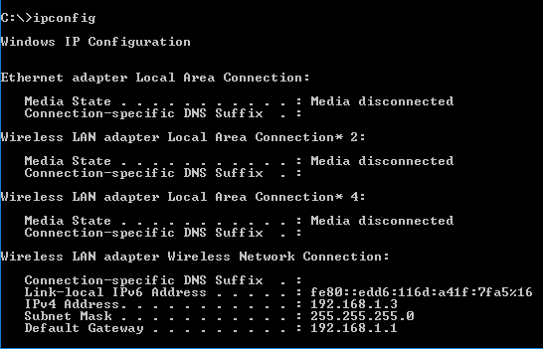
TCP/IP Utilities: ipconfig
The ipconfig utility is used to view your TCP/IP settings, such as:
Network Connections
IPv6 address
IPv4 address
Subnet mask
Default gateway
ipconfig /all displays full details for TCP/IP settings.

Slide 28
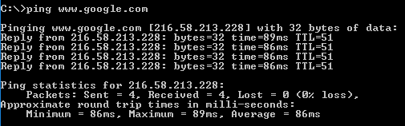
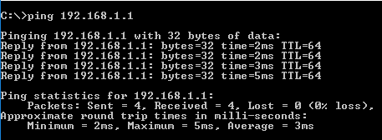
TCP/IP Utilities: ping
The ping utility is used to test communication with another remote host.
The basic syntax for using ping is:
ping target
“target” may refer to a hostname or IP address.

Slide 29
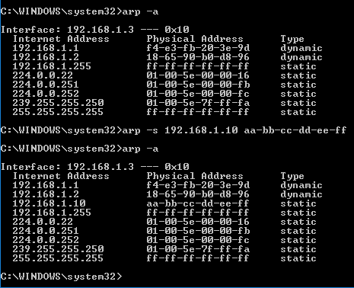
TCP/IP Utilities: arp
The arp utility is used to display and modify (add/delete) the IP-to-MAC address translation tables (i.e. ARP caches).
Some common options of using arp:
arp -a : displays current ARP entries arp -s : adds a host and associates its Internet address with its Physical address. arp -d : deletes a host specified by its internet address.

Slide 30
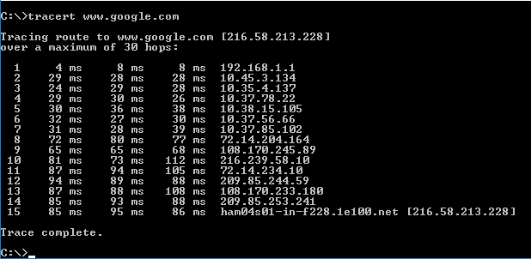
TCP/IP Utilities: tracert
The tracert utility is used to trace the communication path between two computer systems (i.e. source and destination).
Typically, the last hop is the destination IP address.
What about the first hop?

Slide 31
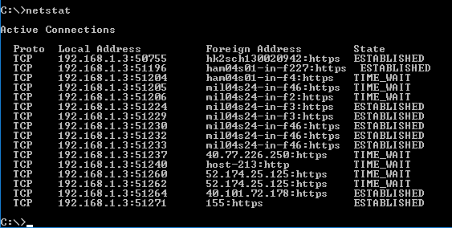
TCP/IP Utilities: netstat
The netstat utility displays protocol statistics and current TCP/IP network connections.

Slide 32
Research Activity
What are private IP addresses? Explain the purpose of using them.
Briefly discuss the purpose and functionality of “Class D” of the IP addresses.
Explore and briefly explain more TCP/IP utilities for testing and troubleshooting the internetwork.

